Slide 1

Optimizing content in government An approach
Patrick Lajeunesse Digital Transformation Office @patlaj

Slide 2
Why do this
Not (necessarily) about end-to-end service design or policy development - just making things work better for people
You will know that things will work for people, instead of just hoping
Notes:
Wrk on specific content or sections of a site
Anything we publish is either helping - or it’s hurting. Having extra content on the web isn’t like publishing a manual that no one looks at. The fact that it’s on the web is going to make it come up in search results. It’s going to get in the way of other content. So if it doesn’t help, it shouldn’t be there.

Slide 3
A recipe for web optimization
A proven approach for web optimization projects that you can use
Research and test with users (GC Digital Standard #1!)
For anyone who’s responsible for web content OR who’s helping someone who is
Mostly geared to revising content or sections, but can apply to new as well
It will cost some money - but rewards are great
Notes:
Whatever you’re publishing - a new campaign, a section to help support a program, a notice about something. It doesn’t really matter so long as there’s a reason to publish it.
You don’t have to do it this way - there are other ways… but this is tested and proven.

Slide 4
Approach overview
Problem definition
Baseline test
Design
Re-test
Success?
Launch
1
2
3
4
Did prototype perform?
As determined by stakeholders
Test the current content with people
Fix content, develop prototype, test and iterate
Task-test the prototype with the public, iterate to improve
Initial research, identify tasks to fix
Notes:
These aren’t phases so much as they are points you need to reach in your process. These will be explained in detail as we go.

Slide 5
Getting set for success
Having the right people involved is key.
Find out who the real stakeholders are
Everyone should attend the kick-off
Key people need to be involved in problem definition, discovery and design
Everyone should view the test results (both baseline and final)
Notes:
You need to identify all of the stakeholders - particularly those who will have an impact on whether what you’re doing goes live. You can be stopped if the right people aren’t involved early on.
Not involving people who have an influence is a sure way to have your work not see the light of day.

Slide 6
Problem definition
1
Notes:
How you frame the problem is a big predictor in whether or not you’ll be successful in solving it.

Slide 7
“Asking your own questions and knowing how to find the answers is a critical part of being a designer”
- Erika Hall, Just Enough Research
Notes:
I’m not going to spend too much time on this because it’s the focus of this afternoon...
Research. That’s all about figuring out what you don’t know, and what you need to know to meet the goals of your project.
This is really a critical part of user-centred design.
Erika Hall has a great quote in “Just enough research” (which is a great book that’s definitely worth reading). She says, “Asking your own questions and knowing how to find the answers is a critical part of being a designer”.
You may say, “Yeah, but I’m not a designer”, but I agree with Jared Spool when he says that anyone who influences the design is in fact a designer. And that includes you, and it includes the DG or ADM who makes certain changes before it goes live. You have to see them as designers because that helps to frame what their influence is.
We put these “things we don’t know” into research questions, and they’re the things we’re going to try to answer with our research.

Slide 8
Research
Solve real problems:
What issues are call centres reporting?
What do analytics tell you about user behaviour?
What do people who use (or could use) the service say?
Are there other sources of information? (past research, surveys, discussion forums, Twitter, Google trends)
Notes:
When talking about research at this early stage, it’s really about understanding the problems.
Sometimes you can’t choose your projects… but you should choose what to focus on.
Cast a wide net in understanding the current use and possible issues around it.

Slide 9
Tasks
What people are trying to do, or a question they’re trying to answer.
When will my parental leave end?
See if your passport can be renewed
Get your T4
Was there a weather alert on (some) date?
Fill out a training form
Notes:
We use tasks as the basic unit of measure for these projects.
Tasks are a lower level than goals, which is what you’re actually trying to achieve.
Then can be broader or more detailed depending on your project needs.
This is where the policy or end-to-end design comes in… if you can influence how easy it is to get a passport, focus on that. If you can help make the process smoother, do that.

Slide 10
Agree on the overall tasks
These must be real things people are trying to accomplish.
They should reflect areas where people are having trouble or that you’d like to improve.
Everyone should agree on the tasks you’ll work on.
Also a great way to control the scope.
Notes:
We use tasks as the basic unit of measure for these projects.
Tasks are a lower level than goals, which is what you’re actually trying to achieve.
Then can be broader or more detailed depending on your project needs.
This is where the policy or end-to-end design comes in… if you can influence how easy it is to get a passport, focus on that. If you can help make the process smoother, do that.

Slide 11
Scenarios
Scenarios are narratives that can be used to test tasks.
Find out when parental leave ends:
“Marie is on parental leave and planning for her return to work. How can she find out when her last payment will be?”
Validate and test your scenarios!
Notes:
6-10 depending on scope… make sure these are realistic and that they’re areas where you need to see an improvement. Test them on people to make sure they’re clear and are testing the right things.

Slide 12
Then…
You’ve engaged your partners and worked with them to define the project
You have tasks and scenarios to test
You’ve learned a lot about the subject area
Now you’re ready to test
Notes:
When talking about research at this early stage, it’s really about understanding the problems.
Sometimes you can’t choose your projects… but you should choose what to focus on.
Cast a wide net in understanding the current use and possible issues around it.

Slide 13
Baseline test
2
Notes:
Figure out things are currently performing - you have your tasks - let people try to accomplish them with your site

Slide 14
Get a baseline measure of task success
Many options depending on your needs and resources:
Moderated usability testing
Unmoderated usability testing
Unmoderated tree/1st click testing
Notes:
A little bit of rigour is necessary here.
You have to test with actual or potential users
Remote allows people to be in their own environment, which is actually an advantage. Not an artificial environment. Also easier to take notes without distracting them.

Slide 15
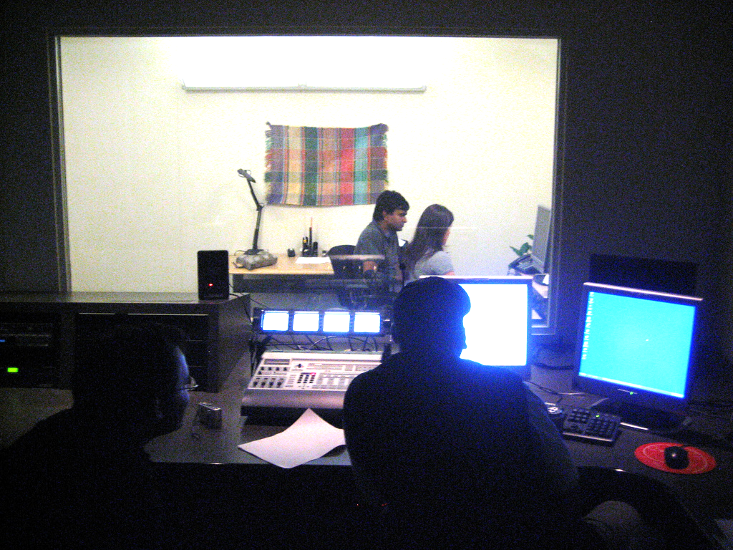
Moderated - in-person lab
Notes:
Oracle - beyond what you need

Slide 16
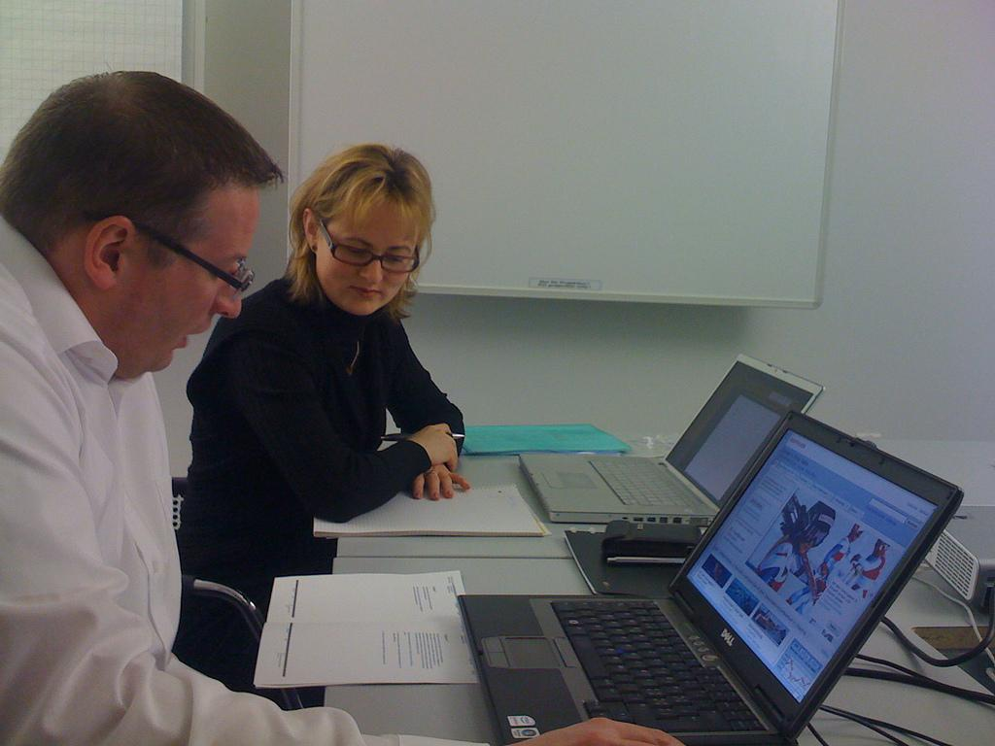
Moderated - in-person
Notes:
In a more realistic scenario - more work to setup and organize, probably costs more… great for internal things though.

Slide 17
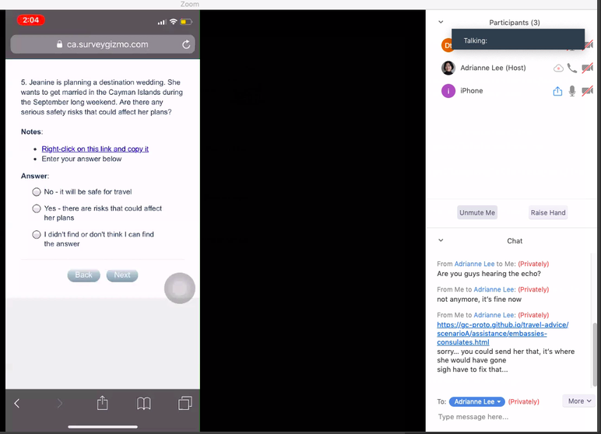
Moderated - Remote
Notes:
Finding someone to test on - main problem here is in controlling the recruiting. Very useful for casual checks though.
In each case, you want to record what’s happening on the screen so you can refer to the videos later.

Slide 18
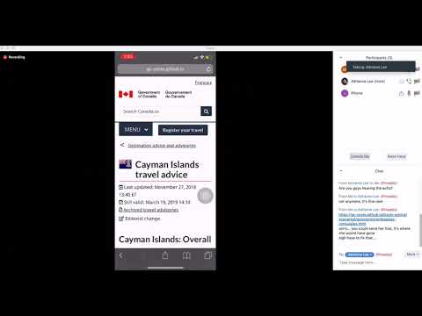
https://youtu.be/lCQjT5_2Pwk

Slide 19

Moderated - Guerrilla (café)
Notes:
Finding someone to test on - main problem here is in controlling the recruiting. Very useful for casual checks though.
In each case, you want to record what’s happening on the screen so you can refer to the videos later.

Slide 20
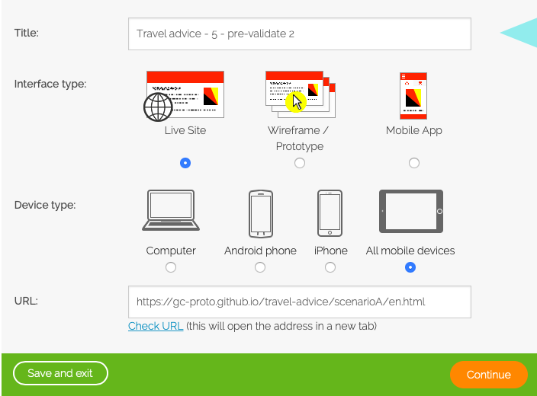
Unmoderated
Notes:
This is TryMyUI but there are many options

Slide 21
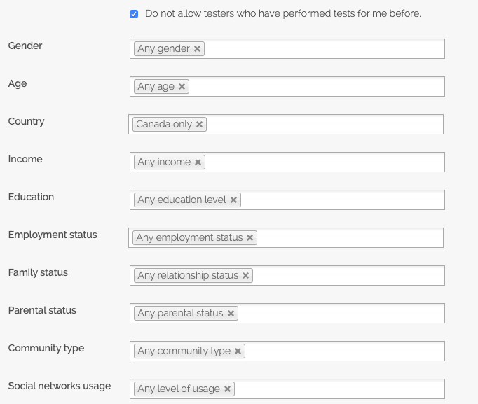
Demographic options
Notes:
This is TryMyUI but there are many options

Slide 22
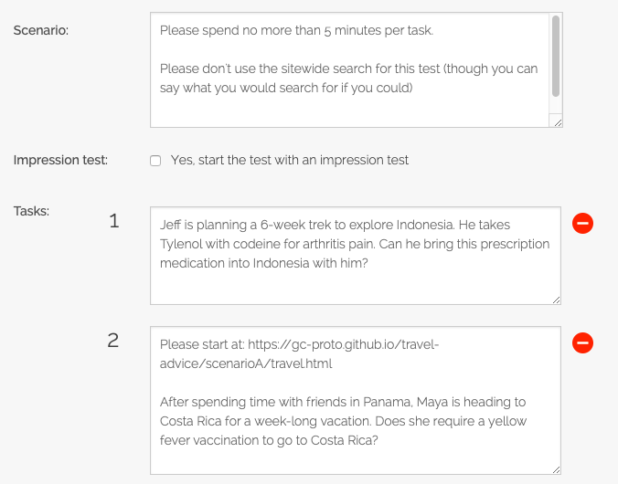
Unmoderated
Notes:
Put in the tasks you want people to accomplish here

Slide 23
Moderated tests can benefit from interventions:
Unmoderated tests can be just as illuminating:
https://www.youtube.com/watch?v=bAKwTLJhVgg
https://www.youtube.com/watch?v=EJtQ4wpQ0xE
https://youtu.be/rRzbWCqfFO4
Notes:
Moderated is better - make sure people are actually answering the task they were assigned. However, sometimes moderated tests don’t have interventions when they’re needed.

Slide 24
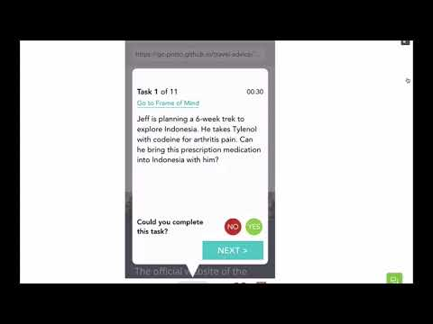

Slide 25
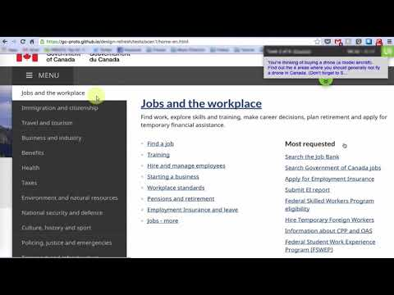

Slide 26
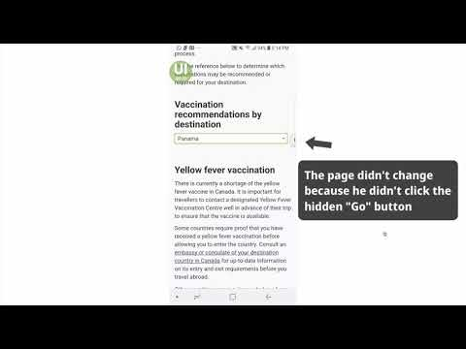

Slide 27
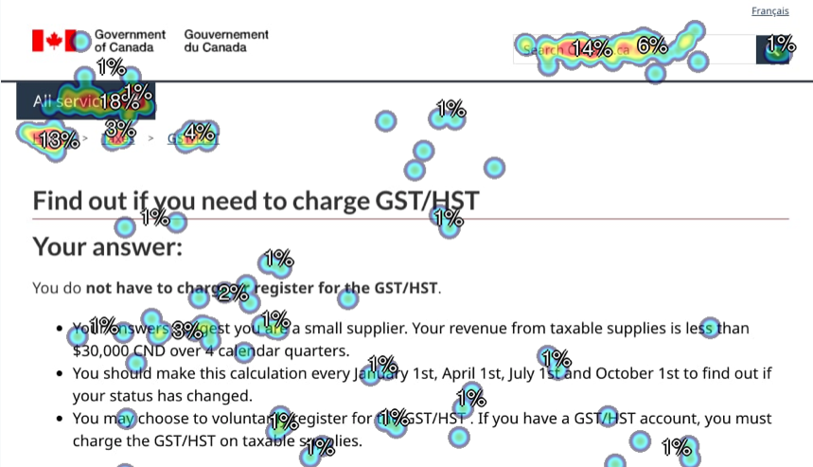
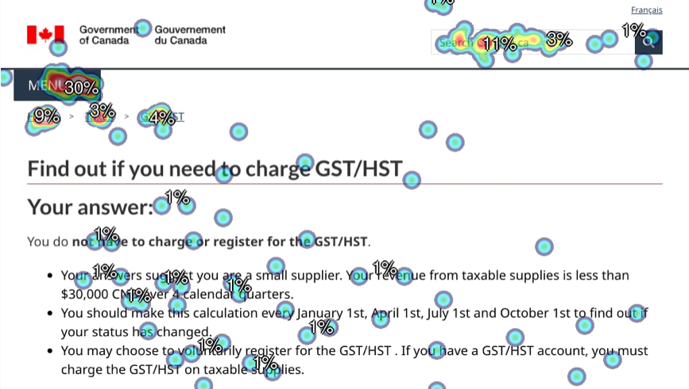
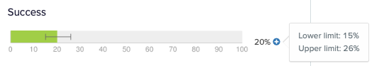
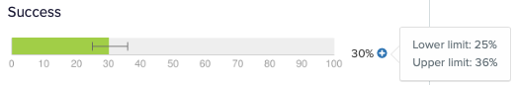
1st-click example - “All services” v. “Menu”
Notes:
“Success” isn’t really the right word here, since searching or clicking “Home” are also valid.

Slide 28
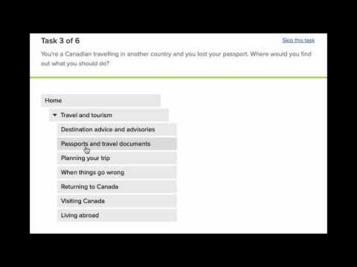
Tree test example
https://youtu.be/OS89PhXy0pc

Slide 29
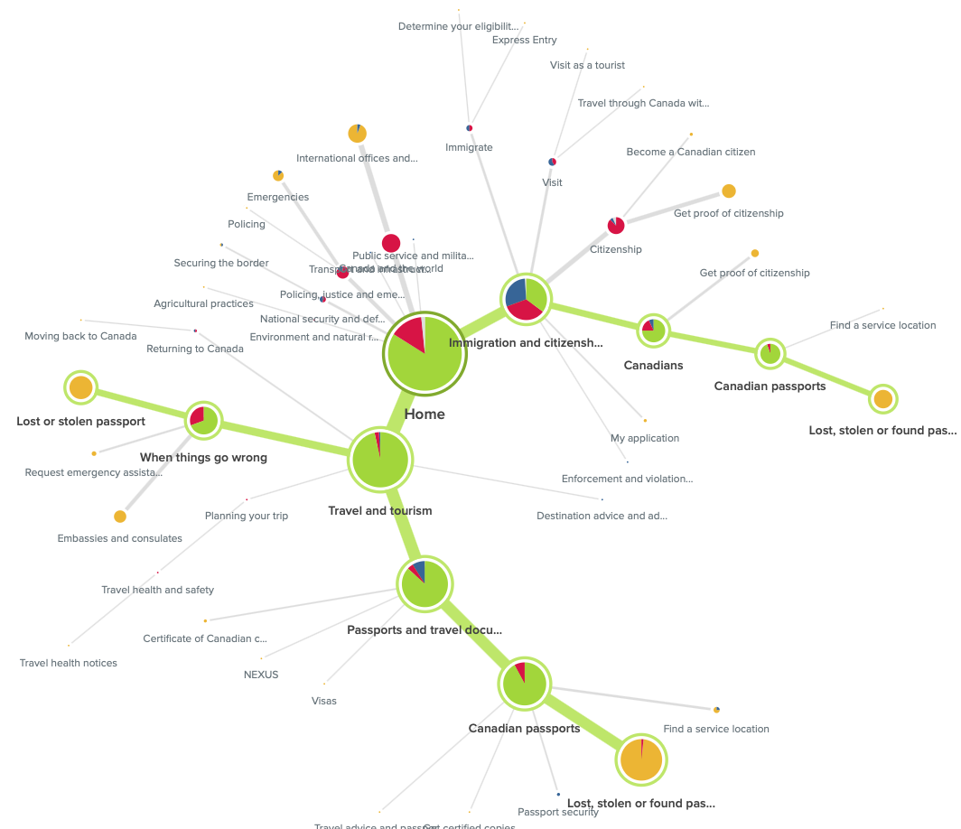
Tree test analysis

Slide 30
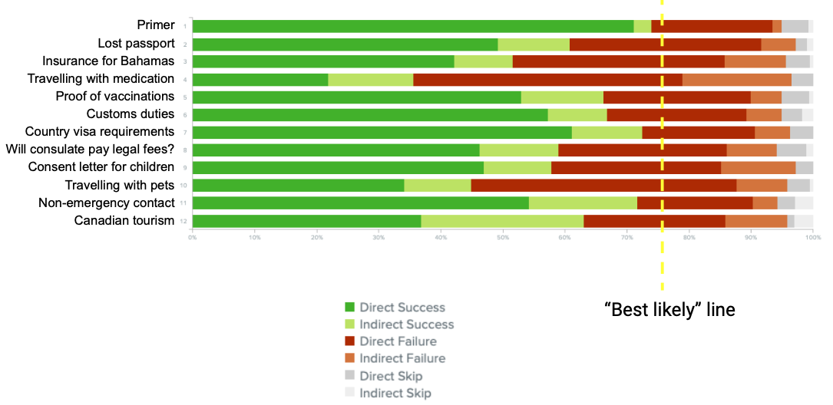
Tree test results

Slide 31
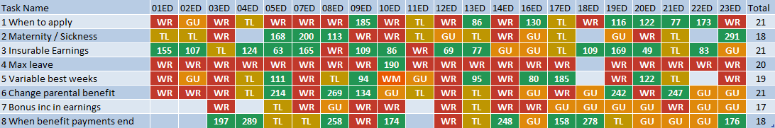
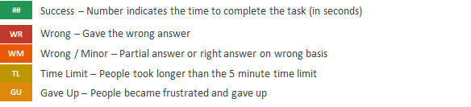
Sample moderated test results

Slide 32
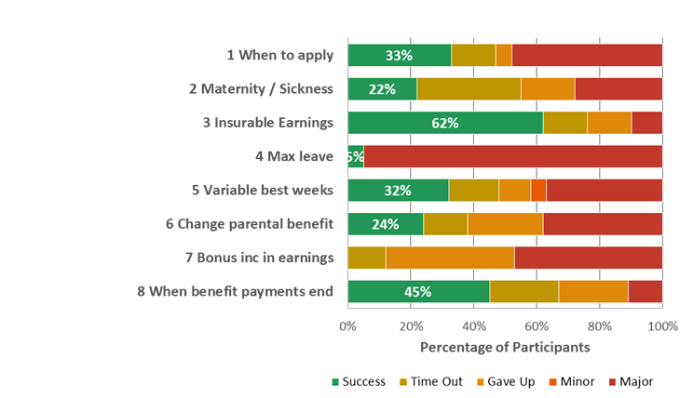
Sample baseline success rates

Slide 33

Analyze and discuss the results
Notes:
After all of your testing is done, you need to analyze the results. Jakob Nielsen did a study where basically 6 users was enough to find a big chunk of the problems with an interface.
As I said, we measure 16-20 users, but that’s because we’re looking for enough people that any change is clear. You will want to use a number like that if you need to report on the percentage of successful participants. But if you’re looking for problems and trying to fix them you can get away with many fewer. Maybe 6-10 is reasonable.
Look at exactly what they did, where they went. Where did they go wrong. Results in a list of issues to address.

Slide 34
Then…
You have a baseline score
You have a lot of video of people attempting tasks
You know exactly how many people did what in each case
You have a list of issues that need to be addressed
All project stakeholders understand the issues and want to get them fixed
Notes:
When talking about research at this early stage, it’s really about understanding the problems.
Sometimes you can’t choose your projects… but you should choose what to focus on.
Cast a wide net in understanding the current use and possible issues around it.

Slide 35
Design and prototype
3
Notes:
Figure out things are currently performing -

Slide 36
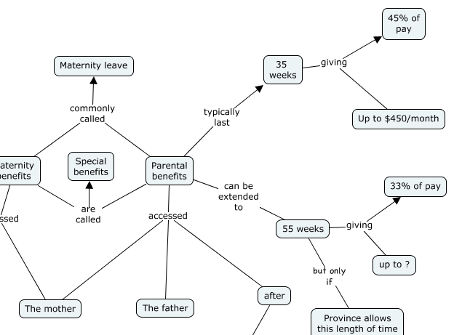
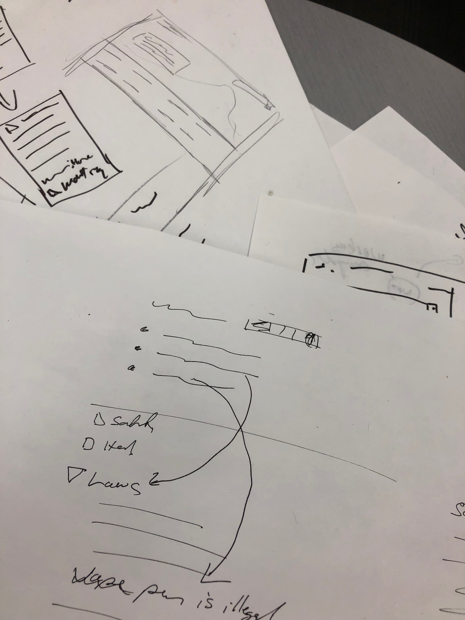
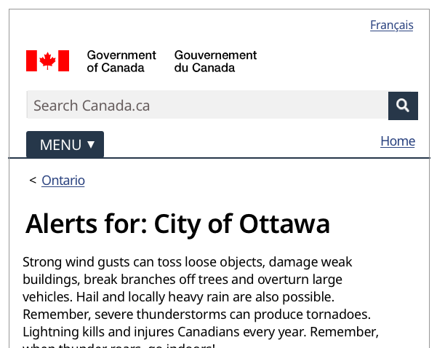
Learn, sketch, iterate
Notes:
Continue to work on understanding the issue as you work on solutions - Including more interviews, interviewing different people. This is where journey mapping, empathy mapping, personas will likely get developed or elaborated.

Slide 37
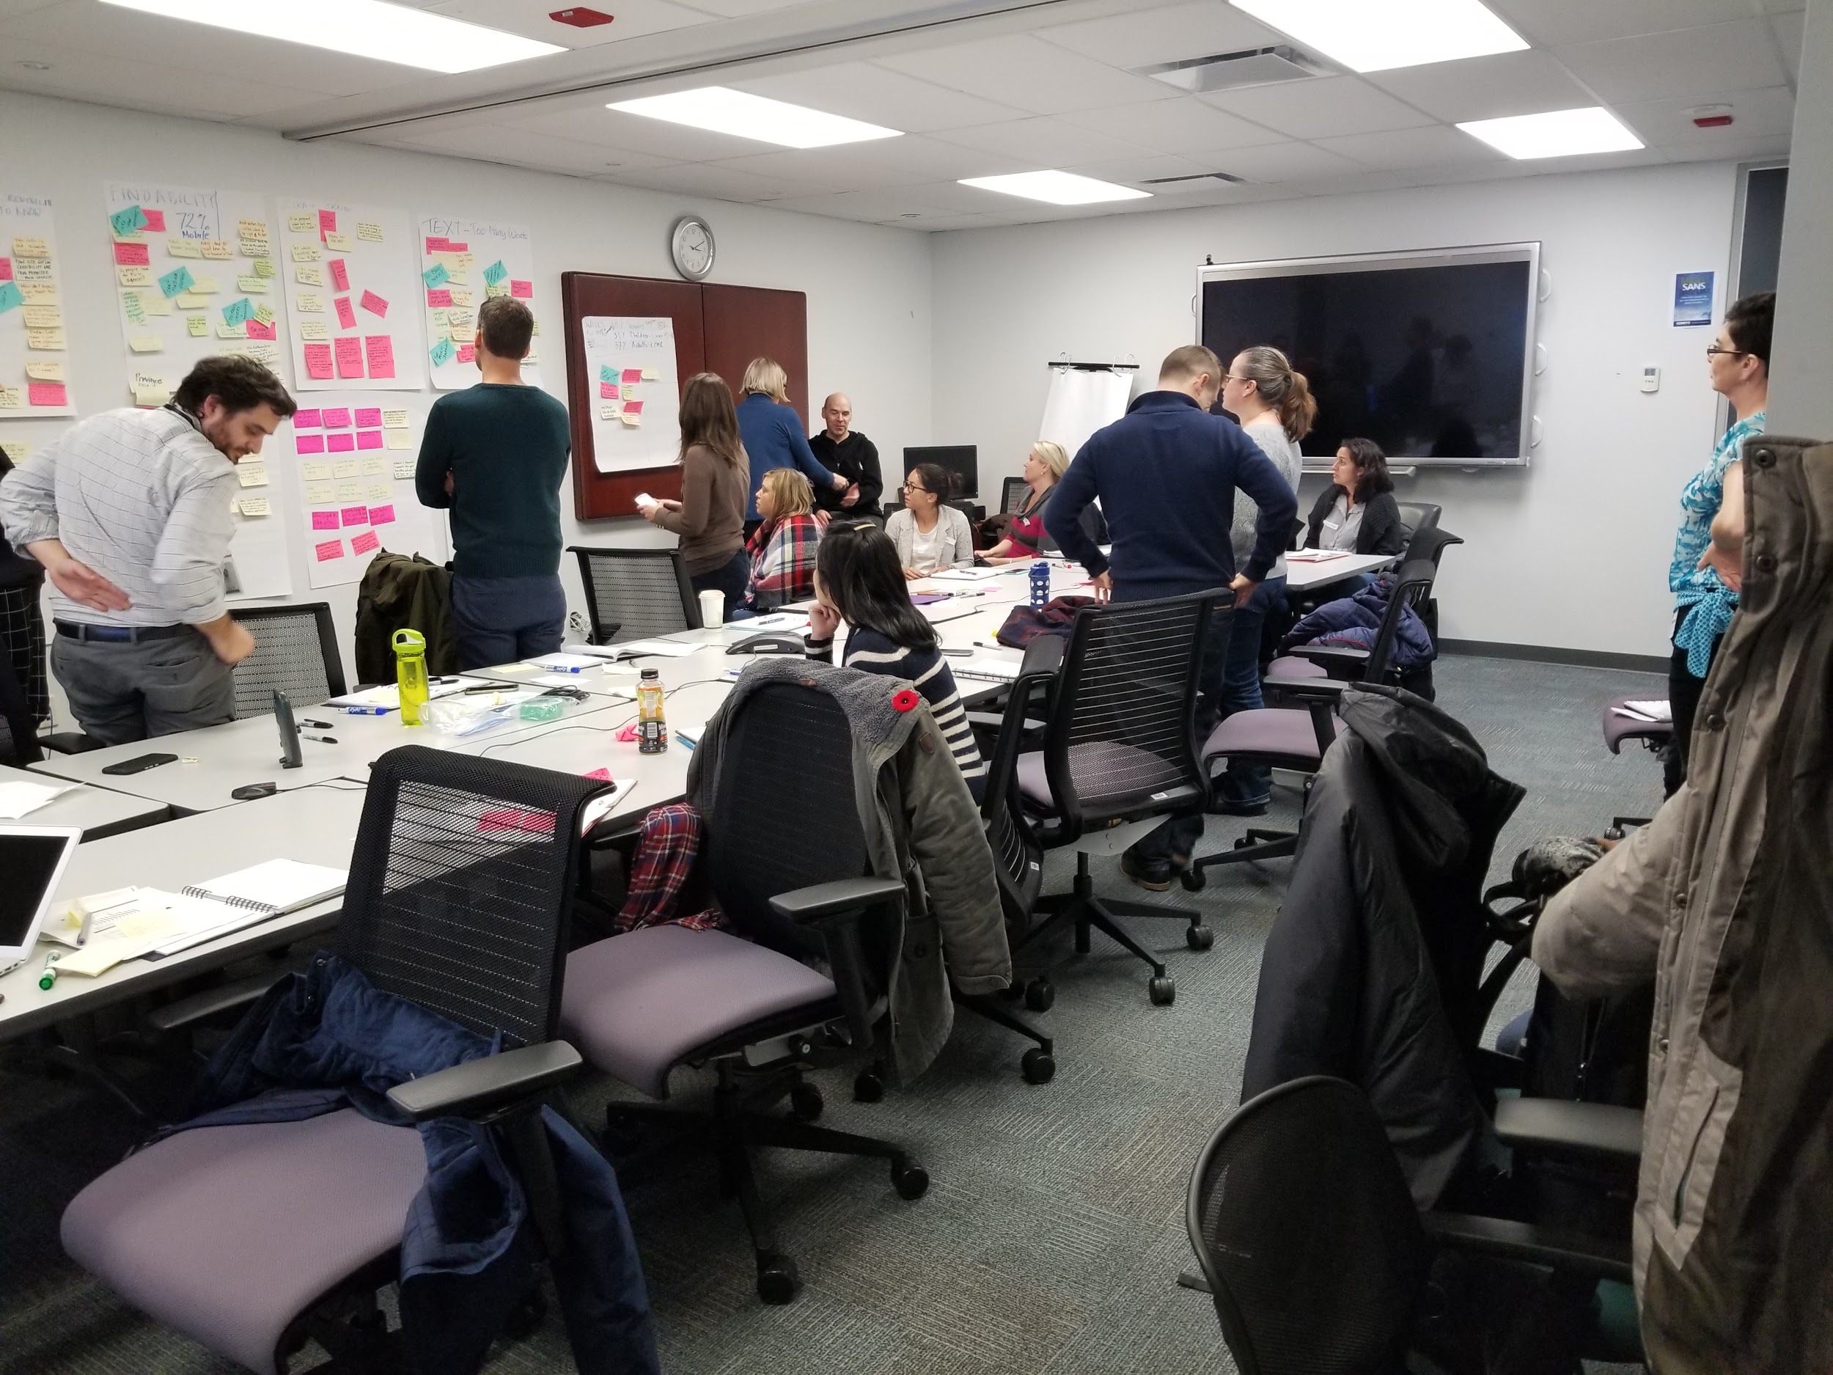
Co-design with your partners
Notes:
This is really key - there’s no point just doing a design in a vacuum and trying to hand it off.

Slide 38
Move to a testable prototype
InVision
Axure
Adobe XD
PowerPoint/Keynote
Github pages
Other web hosts
HTML pages on Github can be the easiest method…

Slide 39
Then…
You’ve worked with your stakeholders on solutions to the problems you’ve found
You have a working prototype that fixes the issues you found
You’ve tested the fixes and feel confident that it’s better

Slide 40
Re-test
4
Notes:
Same rough number of participants, same method of testing. Make changes

Slide 41
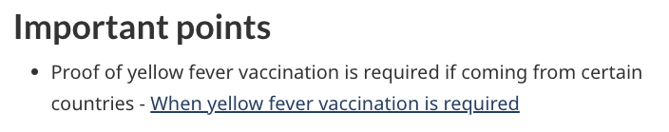
You still might be wrong
No matter how smart or experienced you are, you will be surprised by what you see people do.
One word can make a crucial difference:
https://www.youtube.com/watch?v=QQefFT7DdDA
Notes:
You need a vaccine if you’re coming from countries with yellow fever, with a few exceptions

Slide 42
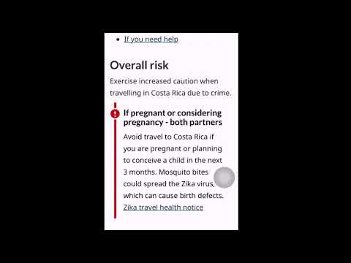

Slide 43
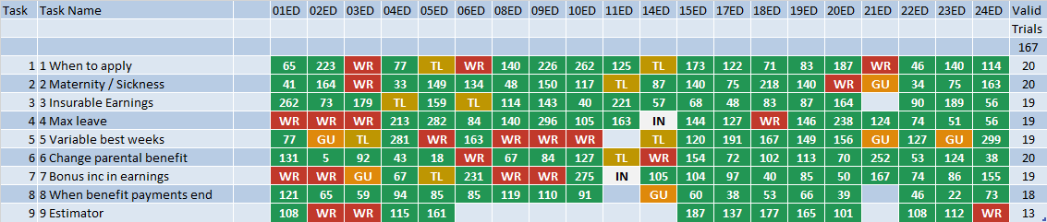
Overall task outcome summary (167 tests)

Slide 44
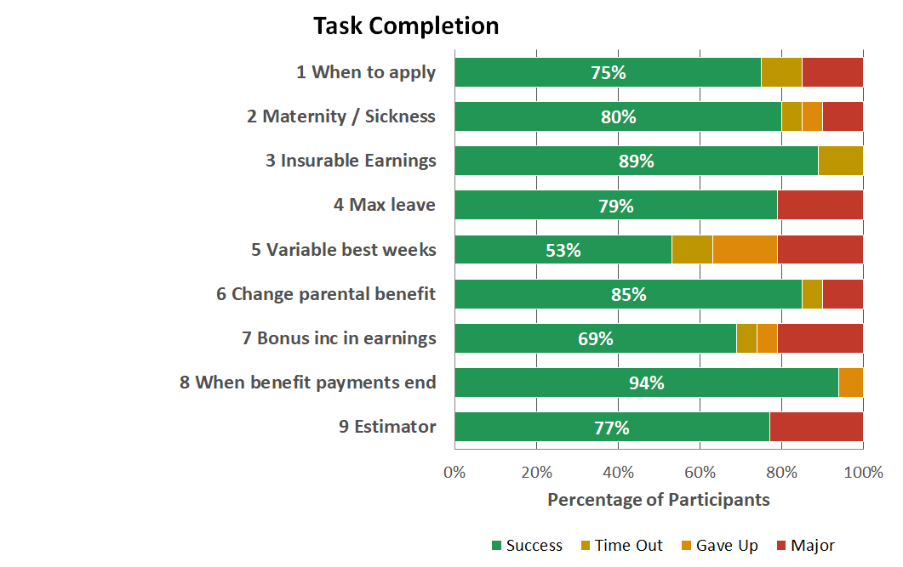
Re-test results

Slide 45
Success?
Notes:
Same rough number of participants, same method of testing. Make changes

Slide 46
Analyze the (new) results

Slide 47
Then…
You have a comparison score to show the results of your work
You have a very good understanding of what helped and why
You’ve presented this information in a way that will help ensure that it gets implemented

Slide 48
Go live
Notes:
This will likely take longer than you expect...

Slide 49
A few resources
Prototyping:
GitHub
Axure
InVision
Adobe XD
Moderated testing:
ScreenFlow (Mac)
SilverBack (Mac)
Camtasia (Mac + Windows)
Unmoderated testing:
Validately (moderated too)
TrymyUI
UserFeel
OptimalWorkshop
Books:
Just Enough Research, Erika Hall
Practical Design Discovery, Dan Brown
Interviewing Users, Steve Portigal
Rocket Surgery Made Easy, Steve Krug

Slide 50
Questions?
Patrick Lajeunesse
Senior Design Researcher / Chercheur en conception principal
Digital Transformation Office / Bureau de la transformation numérique
Treasury Board Secretariat / Secrétariat du Conseil du Trésor du Canada
patrick.lajeunesse@tbs-sct.gc.ca
@patlaj

